Slide 1
VTI of Texas
Trevor Hagerty
Continuous Improvement Manager

Slide 2
History
Founded by Roger Clausen in 1956
Started in a garage fabricating countertops
Doors and cabinets were added
Stone manufacturing was added
Today we have almost completely automated production lines

Slide 3
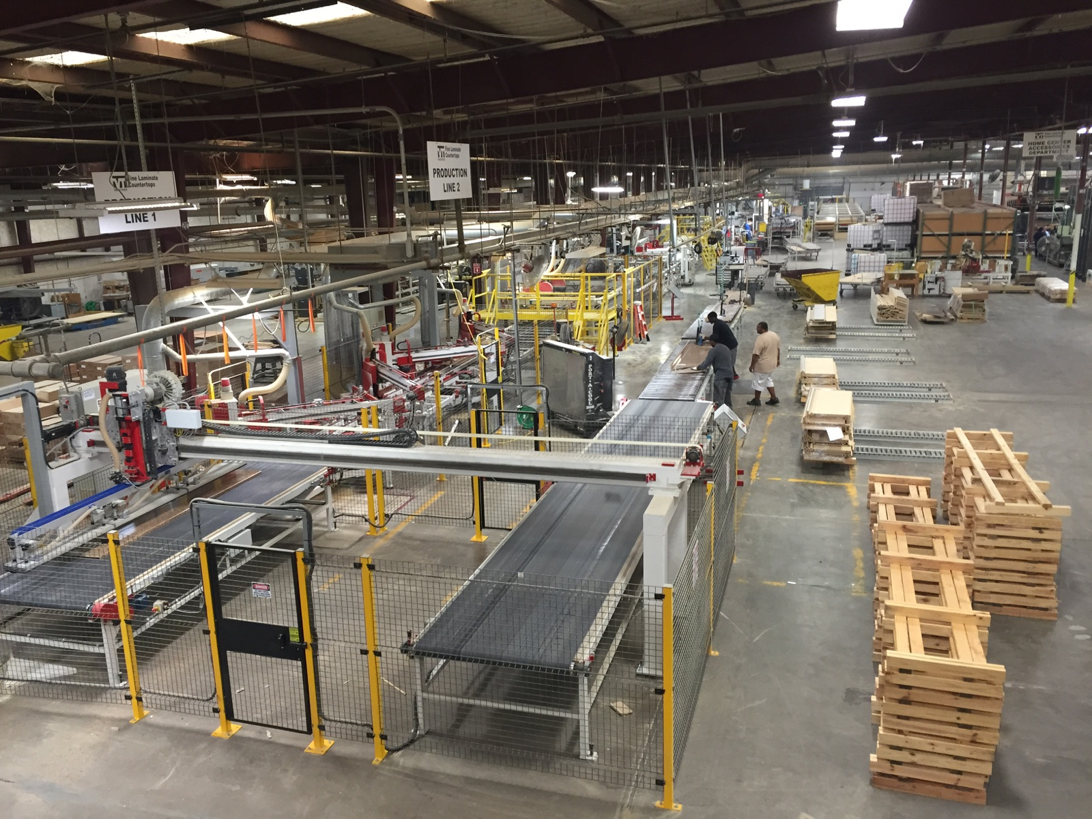

Slide 4
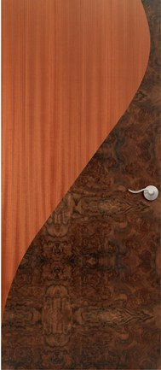
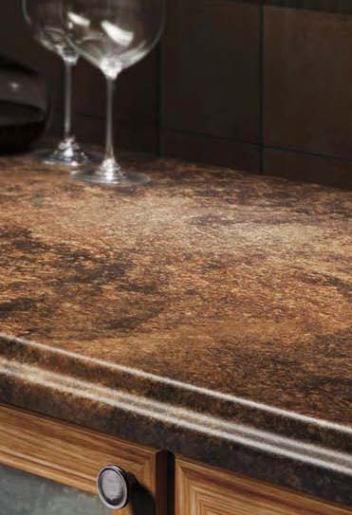
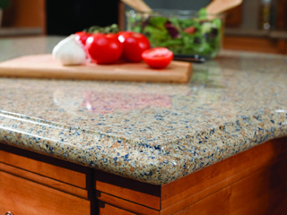
Products
Doors
Laminate Countertops
Stone Countertops

Slide 5
PLANT LOCATIONS
HOLSTEIN, IOWA
Corporate Headquarters
Architectural Wood Doors
SAN ANTONIO, TEXAS
Architectural Wood Doors
BRYAN, TEXAS
Laminate Countertops
  Stone Countertops
LA MIRADA, CALIFORNIA
Laminate Countertops
Stone Countertops
MONTREAL, CANADA
Laminate Countertops
Cabinet Doors
ROME, GEORGIA
Laminate Countertops
Stone Countertops
ROSEBURG, OREGON
Laminate Countertops
  Stone Countertops
SAC CITY, IOWA
Laminate Countertops
    Stone Countertops
HAGERSTOWN, MARYLAND
Laminate Countertops
CLARKSVILLE, IOWA
  Fire Core

Slide 6
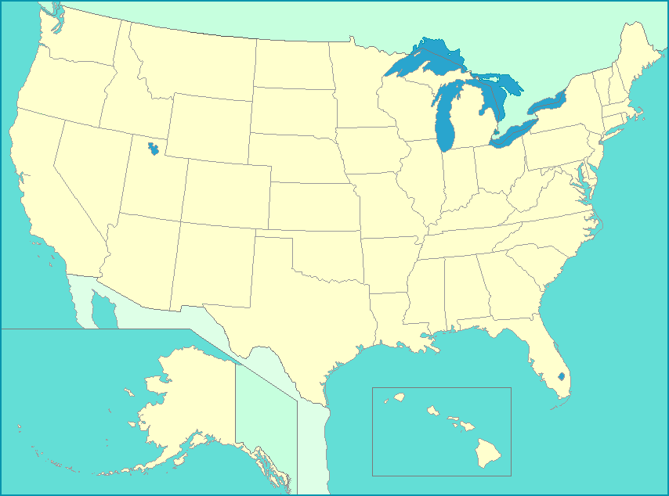

Slide 7
Problem
27 different board types to inventory.
Varying storage capacities, lead times, and shipment quantities.
Need to determine a safety stock, reorder point, and reorder quantity.
Maximize trucks for each order.
We need these quantities to update automatically based on usage.

